Slide 1

NBA Fantasy Player Search
Gahan Sudhir
Yoo Jin Oh
Shruthi Prabahara Sundar
(Group 23)

Slide 2

Table of Contents
Application Description
Implementation
Demonstration
Evaluation
Conclusion

Slide 3

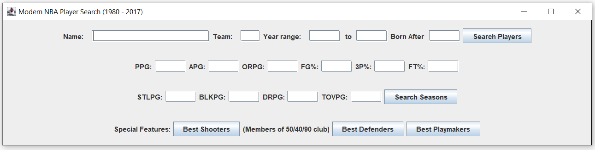
Application Description
Users of this application can search for NBA players who played for a specific team during the modern era (1980s and on). Additionally, they can enter desired statistics and receive a list of player seasons that met or exceeded the criterion input by the user.

Slide 4
Importance of the dataset:
This massive dataset contains the raw data of all players per season. This allowed us to work with seasonal and career statistics of the players. In turn, this allowed us more flexibility when implementing our application features.
Functionality of application:
NBA fantasy players want to select players who played for certain teams, played during a certain era, scored a certain number of points, shot a certain percentage, etc. This application allows users to specify constraints they want in their players and returns to them a list of players or player seasons that supersede or match their inputs. In turn, fantasy players will be better educated on which players to choose.

Slide 5

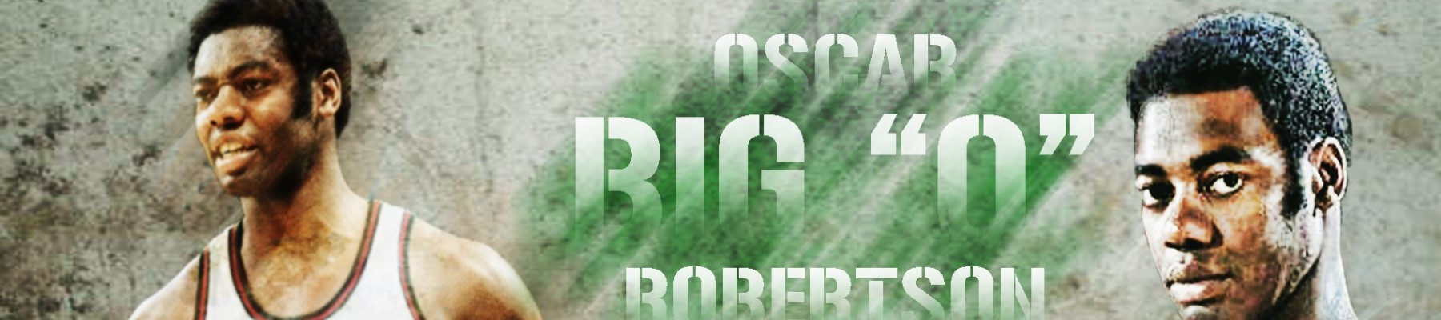
Implementation
Dataset
NBA Players stats since 1950 (https://www.kaggle.com/datasets/drgilermo/nba-players-stats)
Java frontend and backend connected to Mysql using JDBC

Slide 6
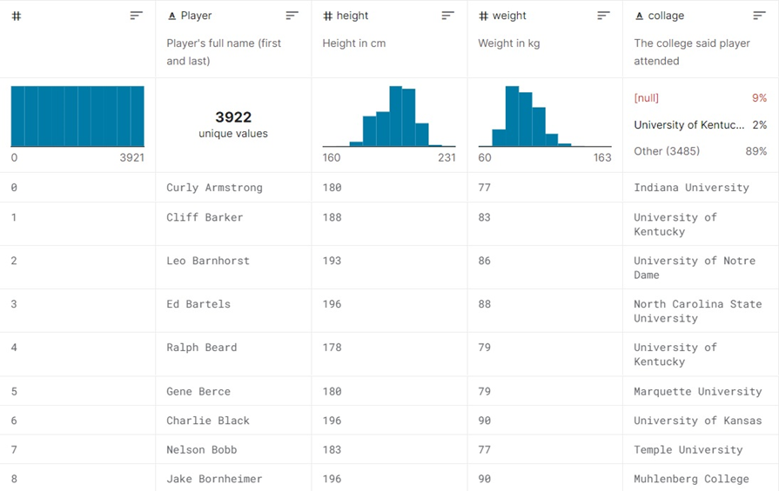
Use only the necessary parts, not everything

Slide 7
Table Size and Information
Team (40 records) in BCNF
Player (2835 records) in BCNF
Offensive Stats (24690 records) in 3NF (functional dependency exists to prime attribute ‘year’)
Defensive Stats (23980 records) in BCNF

Slide 8
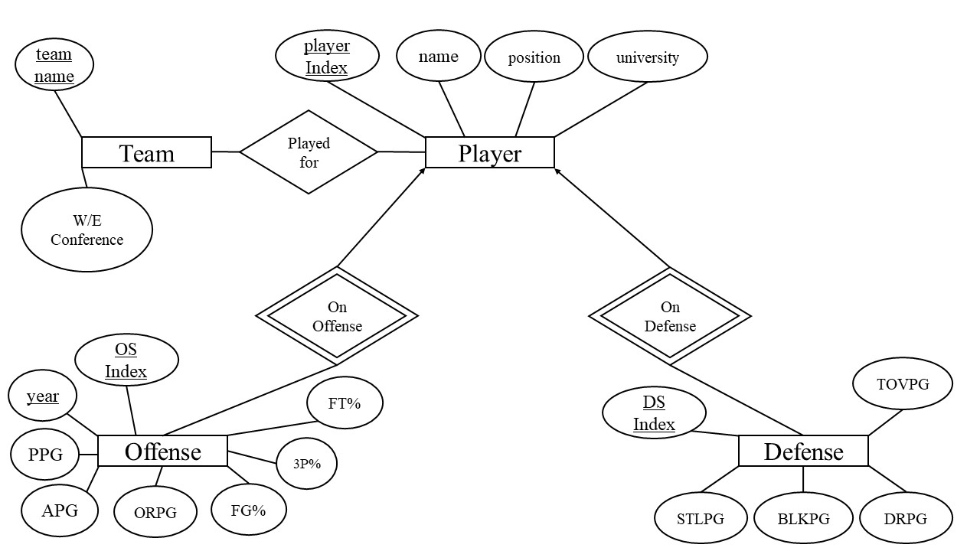

Slide 9
Database Technical Content
Team(teamName, conference)
Player(playerInd, name, position, university)
Offense(OSInd, year, pts, ast, offReb, fgp, tpp, ftp)
Defense(DSInd, stl, blk, defRev, tov)

Slide 10
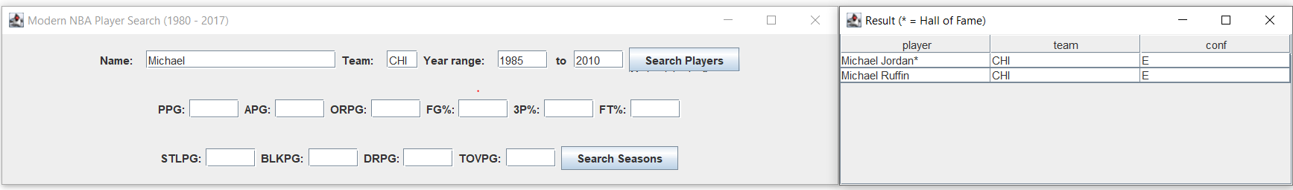
Player Search Query Example
Query sent to mysql (Lvl 2):
select distinct o.player, o.team, t.conf
from offstats o, defstats d, players p, team t
where o.player like "Michael%" and o.team = "CHI" and o.year > "1985" and o.year < "2010" and o.ind = d.ind and o.player = p.name and o.team = t.name
order by o.pts/o.games desc;
4 Different Query possibilities

Slide 11
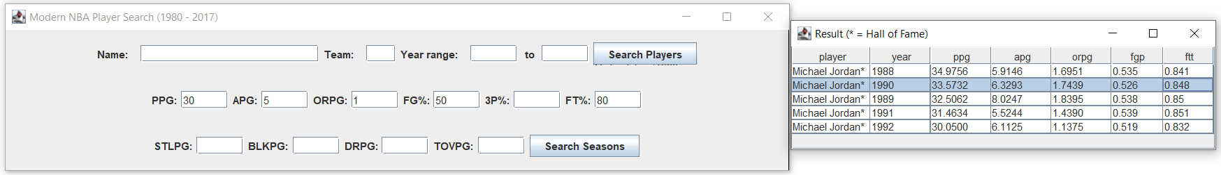
Season Query Example
Query sent to mysql (Lvl 2):
select o.player, o.year, o.pts/o.games as ppg, o.ast/o.games as apg, o.orb/o.games as orpg, o.fgp, o.ftt as ftp
from offstats o, defstats d, players p
where o.pts/o.games > 30.0 and o.ast/o.games > 5.0 and o.orb/o.games > 1.0 and o.fgp > 0.5 and o.ftt > 0.8 and o.ind = d.ind and o.player = p.name
order by o.pts/o.games desc;
Many query possibilities

Slide 12
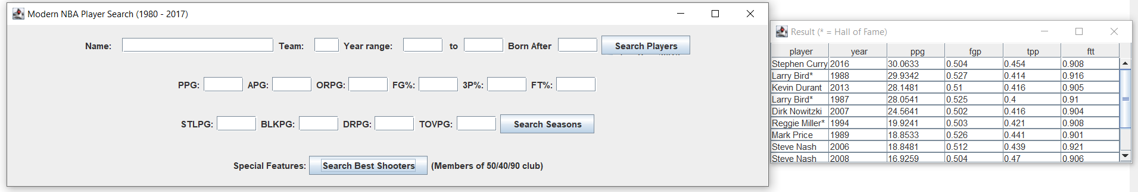
Best Shooters (Stored Procedure):
delimiter $$
drop procedure if exists getShooters;
create procedure getShooters()
begin
select player, year, pts/games as ppg, fgp, tpp, ftt as ftp
from offstats
where fgp > 0.5 and tpp > 0.4 and ftt > 0.9 and pts/games > 10
order by pts/games desc;
end $$
delimiter ;

Slide 13
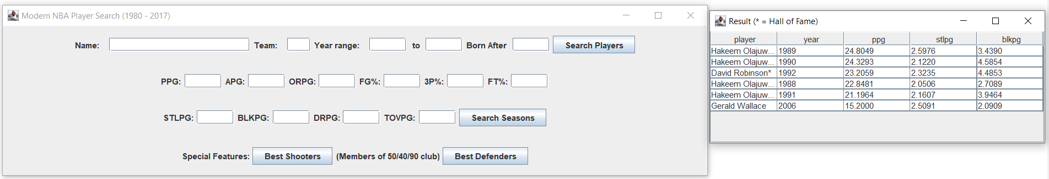
Best Defenders (Stored Procedure):
delimiter $$
drop procedure if exists getDefenders;
create procedure getDefenders()
begin
select o.player, o.year, o.pts/o.games as ppg, d.stl/d.games as stlpg, d.blk/d.games as blkpg
from defstats d, offstats o
where d.ind = o.ind and d.stl/d.games > 2 and d.blk/d.games > 2
order by o.pts/o.games desc;
end $$
delimiter ;

Slide 14
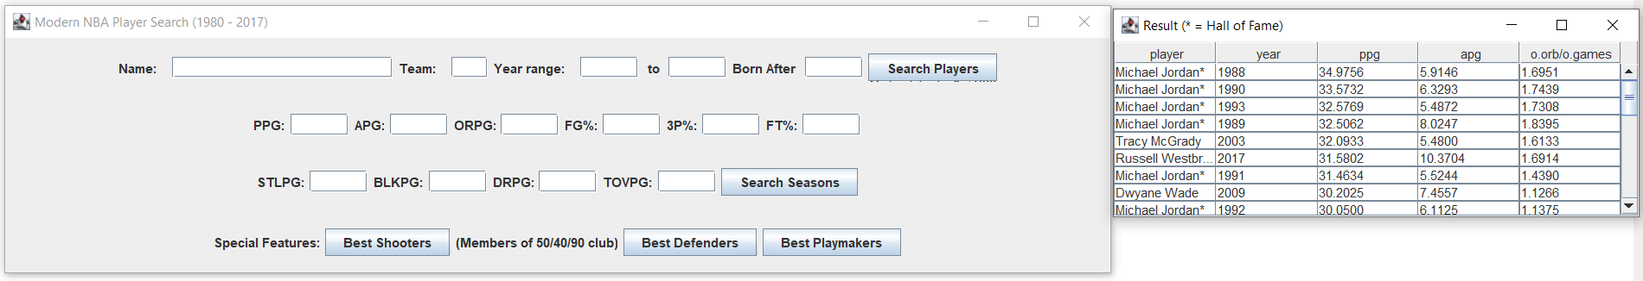
Best Playmakers (Stored Procedure):
delimiter $$
drop procedure if exists modernizeNames;
create procedure modernizeNames()
begin
update team set name = OKC where name = SEA
update team set name = WAS where name = WSB
update team set name = SAC where name = KCK
…
end$$
delimiter;

Slide 15


Demonstration

Slide 17

Challenges of Implementation
Difficulty in establishing relationships between entity set.
Trouble adding on to queries with further user input
GUI challenges

Slide 18
Evaluation

Slide 19
Conclusion
This project showed to us how very specific, useful information can be obtained from massive datasets by taking the time to intelligently design a relational schema, prefilter and normalize our data, and understand sql query structure to create increasingly more complex queries.

Slide 20
Thank you!

